Slide 1
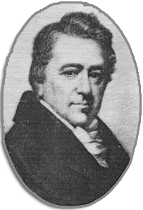
Pierpont Edwards

Slide 2
AGENDA
Life
Masonic Contributions
Politics
Award

Slide 3
Life
Techniques for connecting
  Youngest son of Rev. Jonathan Edwards and Sarah Pierpont, daughter of James Pierpont, a founder of Yale College
  Born in Northampton, Massachusetts on April 8, 1750
  Graduated from Princeton in 1768
  Moved to New Haven to practiced law in 1771
  Post Benedict Arnold Treason, he represented the colony of CT in the Continental Congress
    Forefront to ratify the Constitution

Slide 4
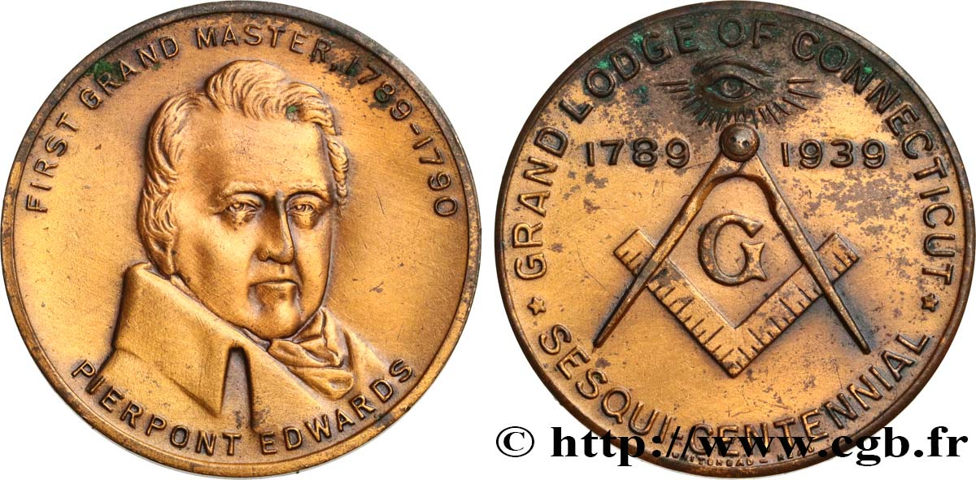
Masonic
Received Masonic light in Hiram Lodge No. 1 December 1775
Served as WM 1777 & 1778 while also serving in the American Revolutionary Army
Named Grand Master of Masons in CT on July 8, 1789 after serving in the effort of creating the Grand Lodge
  His signature appears on the charter of:
  Charter of Moriah Lodge No. 15
  Temple Lodge No. 16
  Federal Lodge No. 17
  Hiram Lodge No. 18
  Washington Lodge No. 19
  On the new charters issued to:
  King Solomon’s Lodge No. 7
  St. Paul’s Lodge No. 11.

Slide 5
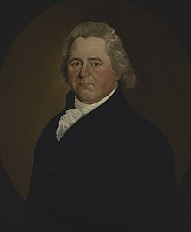
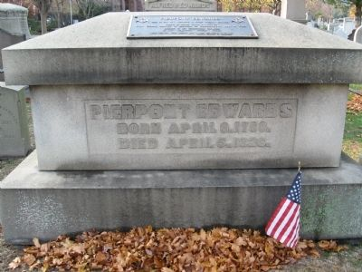
Politics
Founder of CT’s Toleration Party
Played a leading part in the adoption of the CT Constitution of 1818, which served this state until 1965
Edwards was nominated by President Thomas Jefferson on February 21, 1806, to a seat on the United States District Court for the District of Connecticut vacated by Judge Richard Law
He was confirmed by the United States Senate on February 24, 1806, and received his commission the same day.
His service terminated on April 5, 1826, due to his death in Bridgeport, Connecticut

Slide 6
Legacy
Pierpont Edwards died in Bridgeport, Connecticut on April 6, 1826, where he served as a judge of the United States District Court.
His son, Henry W. Edwards, was Governor of Connecticut
His daughter, Henrietta Frances Edwards, was married to inventor Eli Whitney
His nephew, who was only five years younger than himself, was Vice President Aaron Burr.

Slide 7
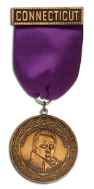
Pierpont Edwards Medal
First conferred upon 10 outstanding Masons at the Special Communication of the MWGL in New Haven Oct. 14, 1939
Award
For consideration provide the brothers:
Birthday
Birthplace
Names of his parents and siblings
Education history
Military service
Place(s) of employment
Wife’s name
Wedding date
Children’s names
Church, community involvement, civic organizations
Detailed information about Masonic history. Blue Lodge and Appendant bodies
Identify anything unique or outstanding in the brother’s life which should be noted in the nomination

Slide 8
THANK YOU

